Slide 1
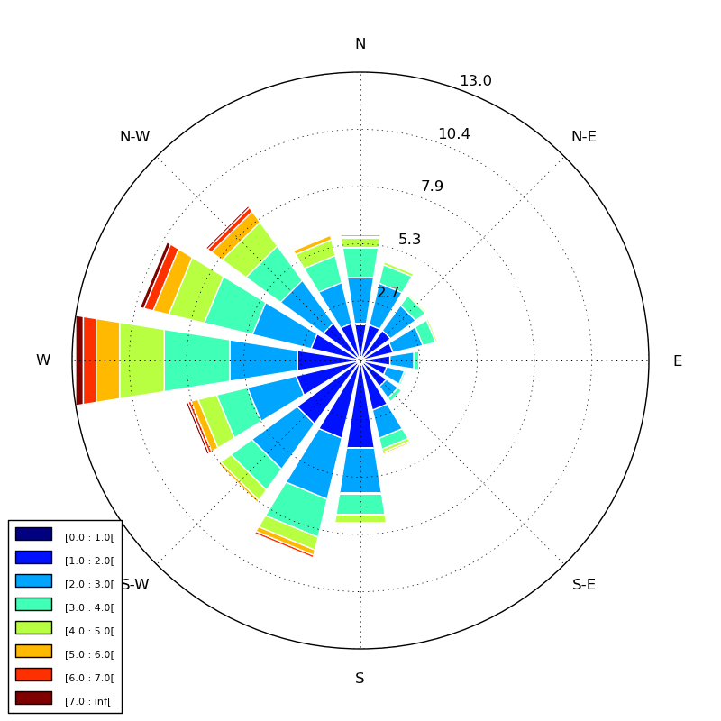
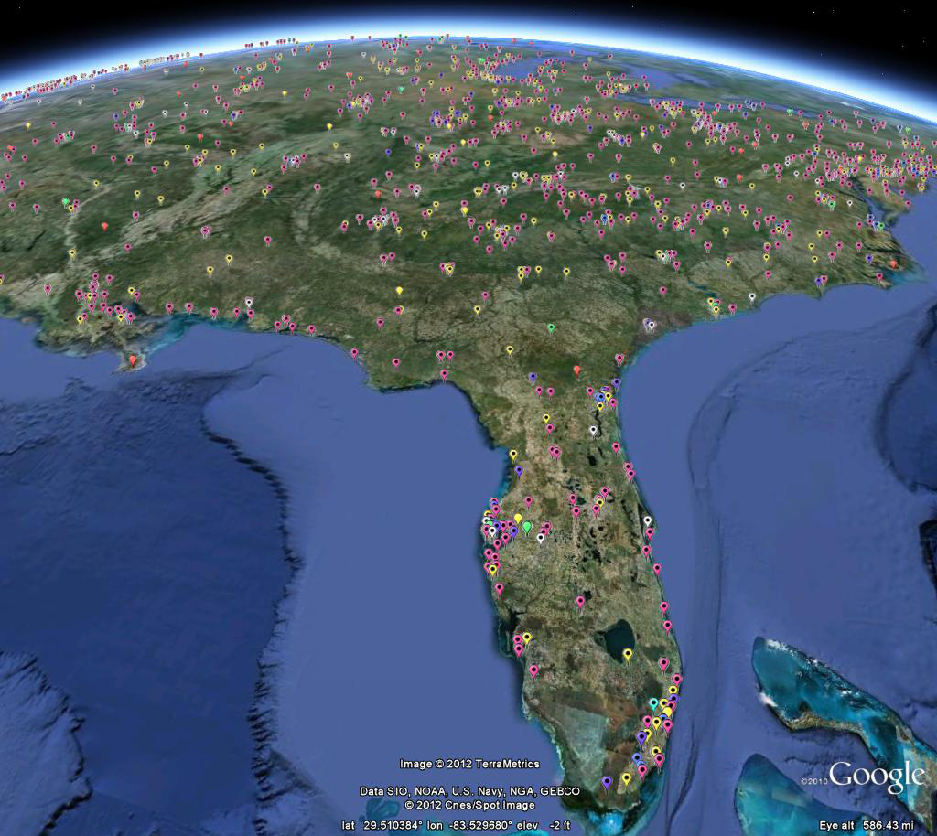
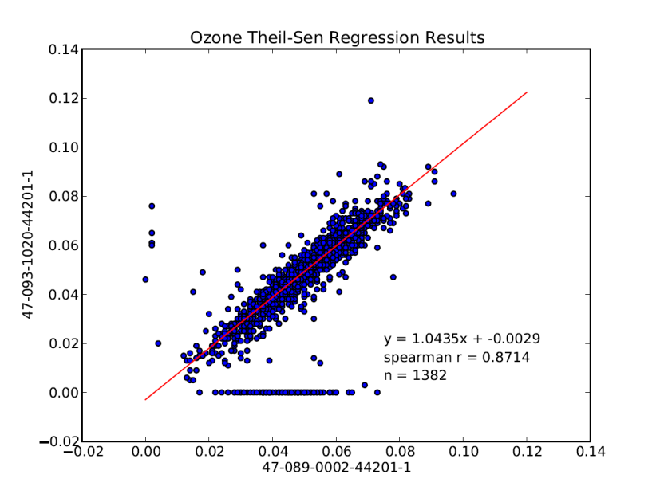

Air Quality Data Analysis Using Open Source Tools
Daniel Garver and Ryan Brown US EPA Region 4

Slide 2

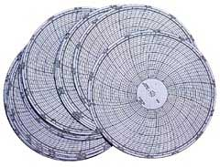
The Problem
Do you ever want to do more than is possible through a standard AQS report? And have it automated?
Do you wish you had additional software but don’t have the resources?
Software like SAS, SigmaPlot, Matlab, etc. is useful for air quality data analysis.
For many agencies, however, these tools are cost prohibitive.
Do you have routine reports or analyses that you currently generate manually and are resource/time intensive?
Notes:
Do you ever want to do more than is possible through a standard AQS report? And have it automated?
Do you wish you had additional software but don’t have the resources?
There’s great commercial software out there like SAS, SigmaPlot, Matlab,… And these tool could provide immense value for air quality data analysis, but they’re expensive.
Do you have routine reports or analyses that you currently generate manually and are resource/time intensive?
Python tools

Slide 3
Outline
About Python
SQL databases and Python - SQLAlchemy
Region 4 Examples:
Ozone site correlations
Air monitoring geodatabase
Automated wind roses and pollution roses
Other potential applications

Slide 4

What is Python?

Slide 5

“Python is a programming language that lets you work more quickly and integrate your systems more effectively. You can learn to use Python and see almost immediate gains in productivity and lower maintenance costs.”
- Python.org
Extremely portable and compatible – the same code runs on Windows, Linux/Unix, Mac OS X and works with existing code in C, C++, Fortran, Java, R, and HTML
Open Source License – free to use (unlimited number of users and licenses) and immediately available for many diverse applications
Strong user base that continually develops and supports python – free add-ons available for database integration, graphing, math/statistics, web development (22,846 add-ons currently available and growing)
Notes:
Support system is also community-based
No traditional tech support
Rather, a large online support community

Slide 6
Same functionality as widely available, costly, commercial software
Free, open source add-ons similar to:
Matlab
SAS
PDF writing software
Graphing software
HTML Web Interface software
Database management/migration software

Slide 7
Using Python With Air Quality Data
Air quality data is almost always stored in an SQL relational database
Examples:
AQS, AQS Datamart (Oracle)
AIRNow (MySQL)
Proprietary air monitoring data management systems such as E-DAS or AirVision (Usually MS SQL Server or Oracle)
State or Local Agency Databases (various platforms)
The first step is to access the data using Python…
SQLAlchemy: a Python add-on

Slide 8

What is SQLAlchemy?

Slide 9
Python and SQLAlchemy
SQLAlchemy is a Python add-on that interacts with relational databases
The same Python code can communicate with any type of SQL database (e.g. Oracle, MySQL, SQL Server, Access)
Python code with SQLAlchemy is easier to read and write than raw SQL
Your data can then be used for other purposes in Python
Notes:
SQLAlchemy is used by organizations such as:
Yelp!
reddit
Mozilla (firefox)
Urban Airship
Survey Monkey
Lolapps
SQLAlchemy can automatically map your existing database! – with the SQL Soup extension

Slide 10
SQLAlchemy – An Example
This Python code…
query = session.query(dm.dim_monitor).join(dm.dim_facility)
Generates this SQL to the AQS Data Mart:
SELECT aqsmart.dim_monitor.dim_monitor_key AS aqsmart_dim_monitor_dim__1, aqsmart.dim_monitor.dim_facility_key AS aqsmart_dim_monitor_dim__2, aqsmart.dim_monitor.dim_substance_key AS aqsmart_dim_monitor_dim__3, aqsmart.dim_monitor.mo_id AS aqsmart_dim_monitor_mo_id, aqsmart.dim_monitor.poc AS aqsmart_dim_monitor_poc, aqsmart.dim_monitor.measurement_scale AS aqsmart_dim_monitor_meas_4, aqsmart.dim_monitor.measurement_scale_definition AS aqsmart_dim_monitor_meas_5, aqsmart.dim_monitor.project_type_code AS aqsmart_dim_monitor_proj_6, aqsmart.dim_monitor.project_type AS aqsmart_dim_monitor_proj_7, aqsmart.dim_monitor.dominant_source AS aqsmart_dim_monitor_domi_8, aqsmart.dim_monitor.probe_location AS aqsmart_dim_monitor_prob_9, aqsmart.dim_monitor.probe_height AS aqsmart_dim_monitor_prob_a, aqsmart.dim_monitor.probe_horiz_distance AS aqsmart_dim_monitor_prob_b, aqsmart.dim_monitor.probe_vert_distance AS aqsmart_dim_monitor_prob_c, aqsmart.dim_monitor.sample_residence_time AS aqsmart_dim_monitor_samp_d, aqsmart.dim_monitor.unrestr_air_flow_ind AS aqsmart_dim_monitor_unre_e, aqsmart.dim_monitor.surrogate_ind AS aqsmart_dim_monitor_surr_f, aqsmart.dim_monitor.collaborating_programs AS aqsmart_dim_monitor_coll_10, aqsmart.dim_monitor.last_sampling_date AS aqsmart_dim_monitor_last_11, aqsmart.dim_monitor.etl_last_load_process AS aqsmart_dim_monitor_etl__12, aqsmart.dim_monitor.etl_last_load_date AS aqsmart_dim_monitor_etl__13
FROM aqsmart.dim_monitor JOIN aqsmart.dim_facility ON aqsmart.dim_facility.dim_facility_key = aqsmart.dim_monitor.dim_facility_key

Slide 11
Once you have access to your air quality data in Python, you can:
Perform statistical analysis
Create graphs
Export data for other applications (e.g. Excel)
Display your data in a web interface
Create PDF reports
Load data into another database (e.g. for GIS)
Perform geoprocessing
Perform automated analysis for data validation or QA/QC

Slide 12
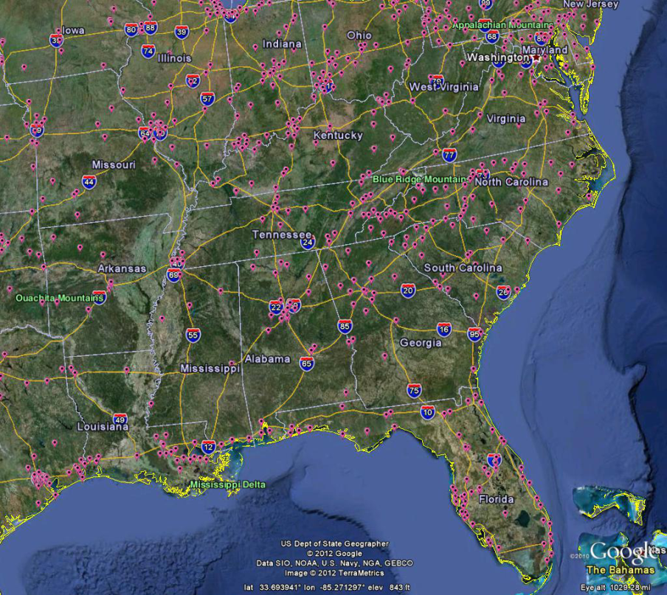
An AQS Example: Ozone Site Comparison Regressions (with Graphs!)
Can be run in minutes! Continually useful!
Graphs!

Slide 13
Ozone Site Comparison Regressions
Compares one site with all other sites in the CBSA based on daily maximum 8-hr average
Generates nonparametric Theil-Sen Regression plots of each site pair
Calculates correlation statistics
Spearman’s r, Pearson’s r, etc.
Potential uses:
Evaluating network design (identifying redundant sites)
Modeling concentrations in the event of missing data
Notes:
Outputs results in a pdf and a text file table

Slide 14
Ozone Site Comparison Matrix
Site A | Site B | n | Spearman r | Spearman p-val | Pearson r | Pearson p-val | Theil slope | Theil int
47-093-1020-44201-1 | 47-093-0021-44201-1 | 1444 | 0.951914952 | 0 | 0.943372755 | 0 | 0.94118 | 0.00185
47-063-0003-44201-1 | 47-093-0021-44201-1 | 292 | 0.941248585 | 9.46E-139 | 0.933572848 | 2.90E-131 | 0.91892 | 7.00E-05
47-105-0108-44201-1 | 47-093-0021-44201-1 | 93 | 0.912599594 | 4.10E-37 | 0.900784971 | 1.00E-34 | 0.75 | 0.01025
47-089-0002-44201-1 | 47-093-0021-44201-1 | 1417 | 0.877047948 | 0 | 0.733866562 | 6.64E-240 | 1 | -0.001
47-105-0109-44201-1 | 47-093-0021-44201-1 | 1327 | 0.832461933 | 0 | 0.704831416 | 7.99E-200 | 0.88889 | 0.00411
47-001-0101-44201-1 | 47-093-0021-44201-1 | 1420 | 0.825591772 | 0 | 0.693255698 | 5.94E-204 | 0.92453 | 0.00421
47-009-0101-44201-1 | 47-093-0021-44201-1 | 1482 | 0.747143127 | 7.83E-265 | 0.641101197 | 2.45E-172 | 0.91667 | -0.00271
47-155-0101-44201-1 | 47-093-0021-44201-1 | 1484 | 0.726548204 | 8.57E-244 | 0.619745174 | 3.62E-158 | 1.03571 | -0.00966
47-155-0102-44201-1 | 47-093-0021-44201-1 | 1102 | 0.655271896 | 3.59E-136 | 0.474699528 | 5.18E-63 | 0.94118 | -0.00524
47-009-0102-44201-1 | 47-093-0021-44201-1 | 1425 | 0.637935642 | 1.17E-163 | 0.535401114 | 1.65E-106 | 0.85714 | 0.00771

Slide 15
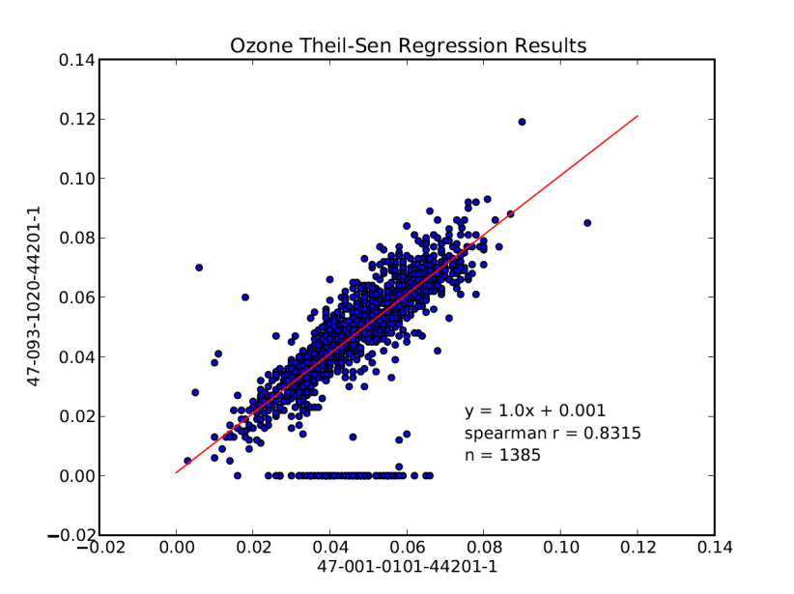
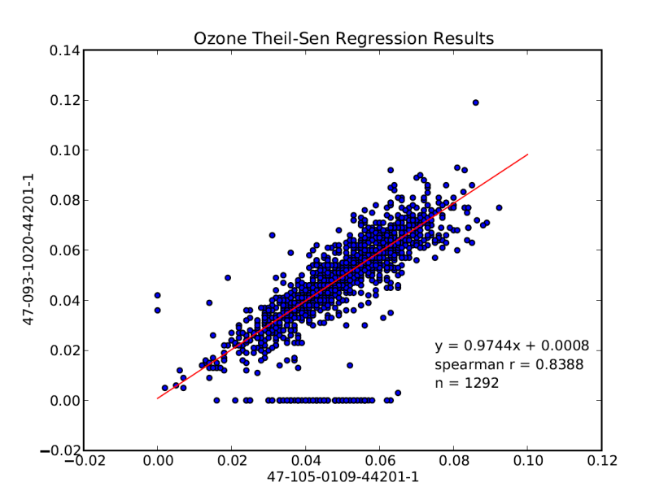
Regression Plots: Selected Southeast Sites

Slide 16
Example: An Air Monitoring Geodatabase
Custom AQS Data Mart Queries
New database design is created in geodatabase
Data loaded into a geodatabase
Python scripting in GIS can automatically create custom layers and feature classes

Slide 17
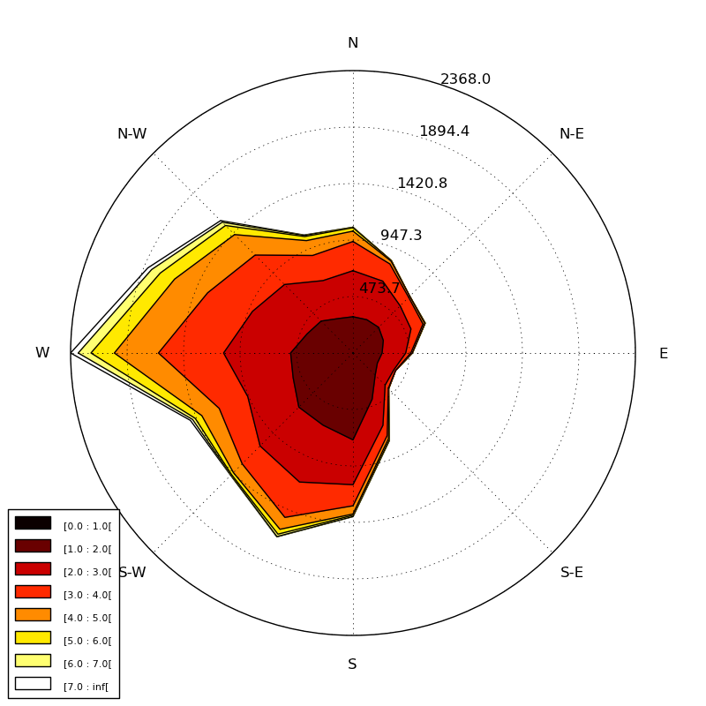
Example: Air Pollution Wind Roses
Customized AQS Data Mart query pulls:
Concentration data over a certain value (e.g. SO₂ > 75 ppb)
Corresponding wind speed and direction for those hours with high concentration
Another Python add-on is used to generate a wind rose or pollution rose of the hours with high concentration

Slide 18
Other possibilities for air quality data
Object wrappers/framework for retrieving data from specific databases (e.g. AQS Datamart)
Could design complex queries with less coding
Speed up development time for specific analysis, graphing, web development functionality
Python powered web interface
Data retrieval, analysis/graphics, and web connectivity can be coded all together

Slide 19
Summary
Agencies rely on air quality data analysis for planning and decision making
State, Local, and Federal Budgets are being cut
Data analysis automation can provide real value
Time savings
Better, more reliable analysis
Python is a free tool that can help achieve this goal:
Easy to learn and read
Ideal for scientists and engineers (part time programmers)

Slide 20
Additional Resources
Daniel Garver
garver.daniel@epa.gov
404-562-9839
Ryan Brown
brown.ryan@epa.gov
404-562-9147
Python: www.python.org
SQLAlchemy: www.sqlalchemy.org
Codecademy Python course (free): www.codecademy.com/tracks/python
Notes:
We are happy to share our code/knowledge and collaborate with anyone else interested.

Slide 21
Questions?

